Slide 1

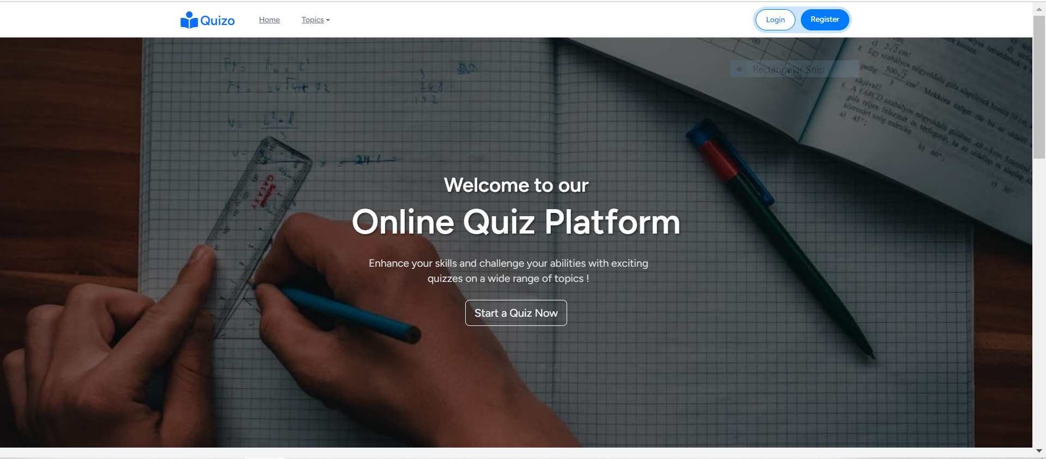
DEPI GRADUATION PROJECT
Online Quiz System
INSTRUCTOR: AMR MOHAMED

Slide 2


Team Members
MENNATUALLAH NABIL
ANTON RIZK
ENGY MOHAMED
MOHAMED AHMED MOUSA
GHADA AHMED

Slide 3

Contents
INTRODUCTION
OBJECTIVES
TECHNOLOGIES USED
DATABASE SCHEMA
FEATURES & FUNCTIONALITY
QUIZ SYSTEM FEATURES
USER DASHBOARD
ADMIN DASHBOARD
CONCLUSION

Slide 4

Introduction
WEB-BASED APPLICATION USING PHP, LARAVEL, MYSQL.
ENABLES TEACHER TO MAKE QUIZZES, TRACK SCORES, VIEW PERFORMANCE HISTORY FOR QUIZZES.

Slide 5


Objectives
a user-friendly platform for quiz-taking.
quiz creation and management features.
Provide score tracking, performance history and pdf print .
Secure user authentication and role-based access control as admin, or user.

Slide 6

Technologies Used
DATABASE
MySQL
FRONTEND
HTML5, CSS3, JavaScript, Bootstrap5
BACKEND
AUTHENTICATION
PHP 8.0, Laravel 9.0
Laravel Breeze

Slide 7
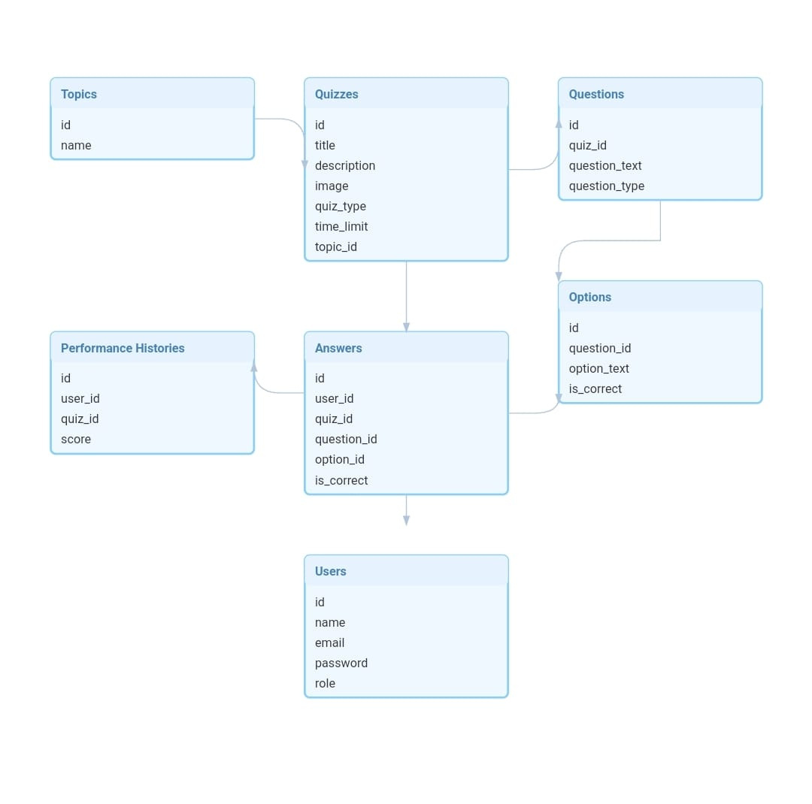

Database Schema

Slide 8
Features & Functionality
User Management:
Registration
Authentication,
Role-Based Access (Admin, User).
Admin Dashboard:
Add, delete, edit topics, quizzes, and questions.
View, search, and manage users.
View quiz takers for each quiz with their attempt date.
Reporting: Quiz performance statistics.

Slide 9


Quiz System Features
Quiz Creation: Titles, descriptions, topics, time limits, type of attempts.
Quiz Display: Timed quizzes, multiple-choice and true/false options.
Scoring System: Real-time feedback on user performance.

Slide 10

User Dashboard

Slide 11
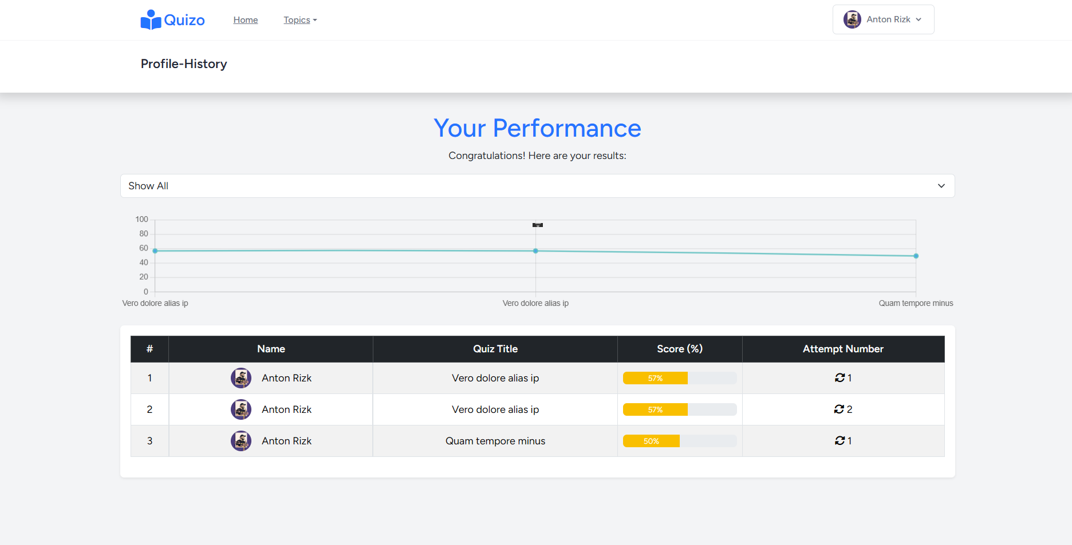
User Dashboard
Performance History:
View quizzes taken and individual scores.
Trends chart

Slide 12
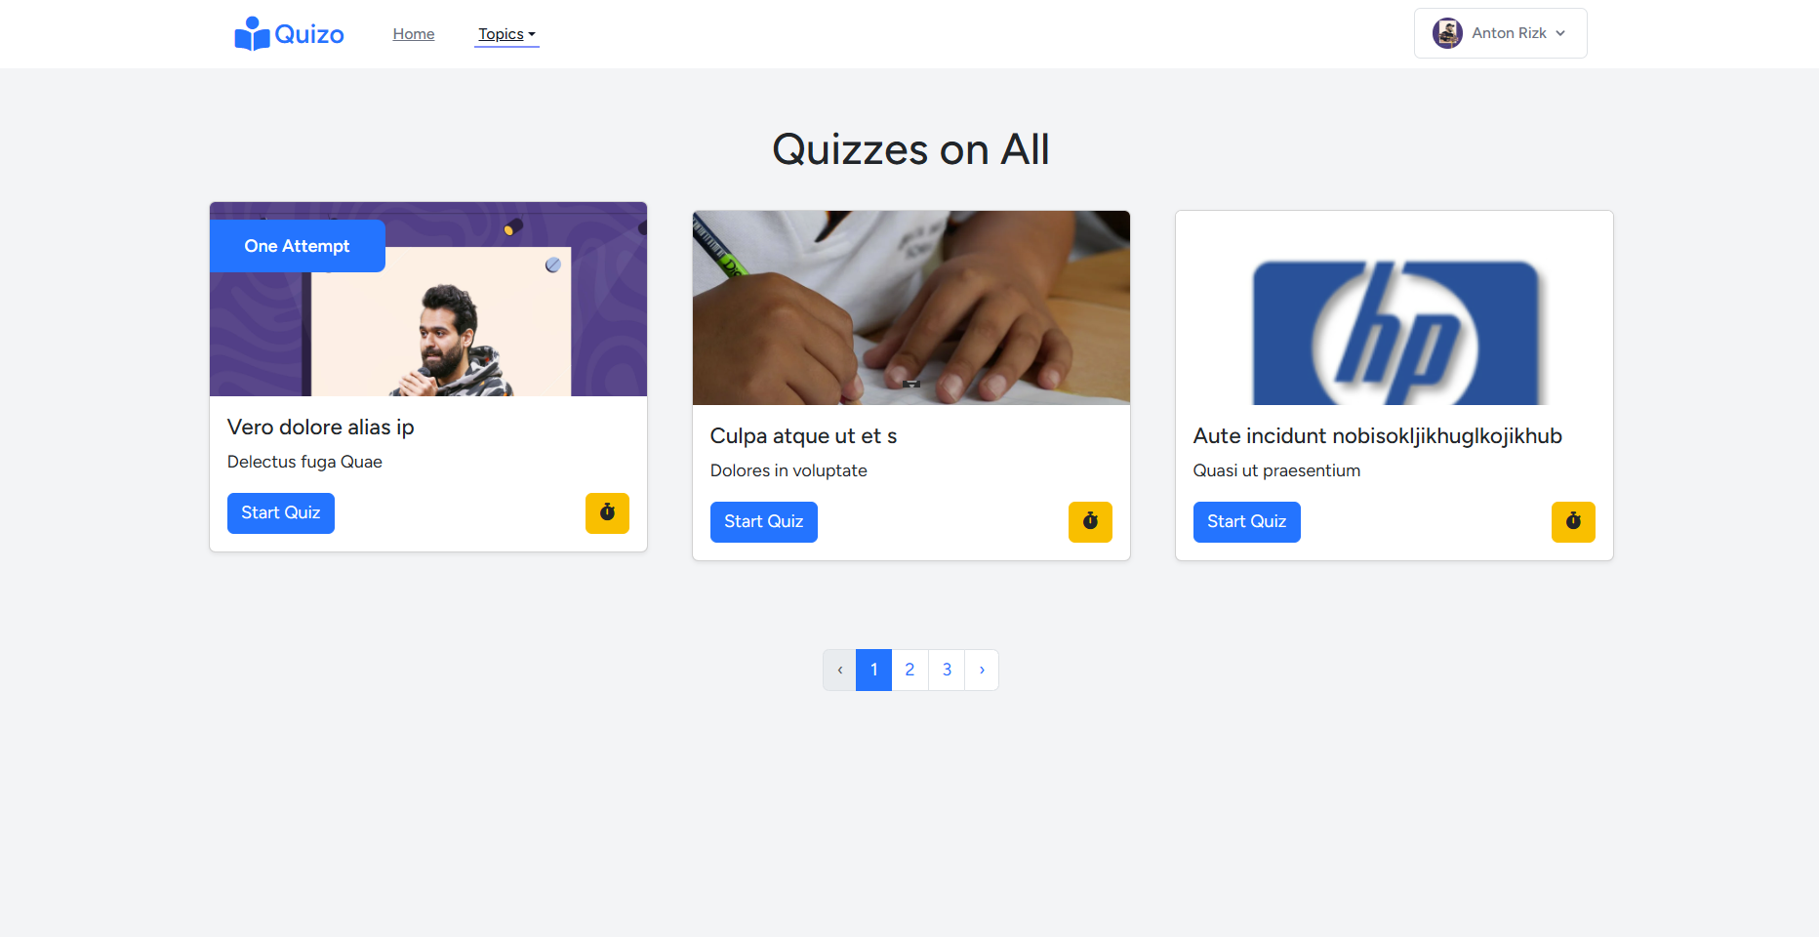
User Dashboard
Quizzes displaying:
can be filtered based on topics.
Have two attempting types: one attempt, multiple attempts.
time-limited questions are indicated.

Slide 13
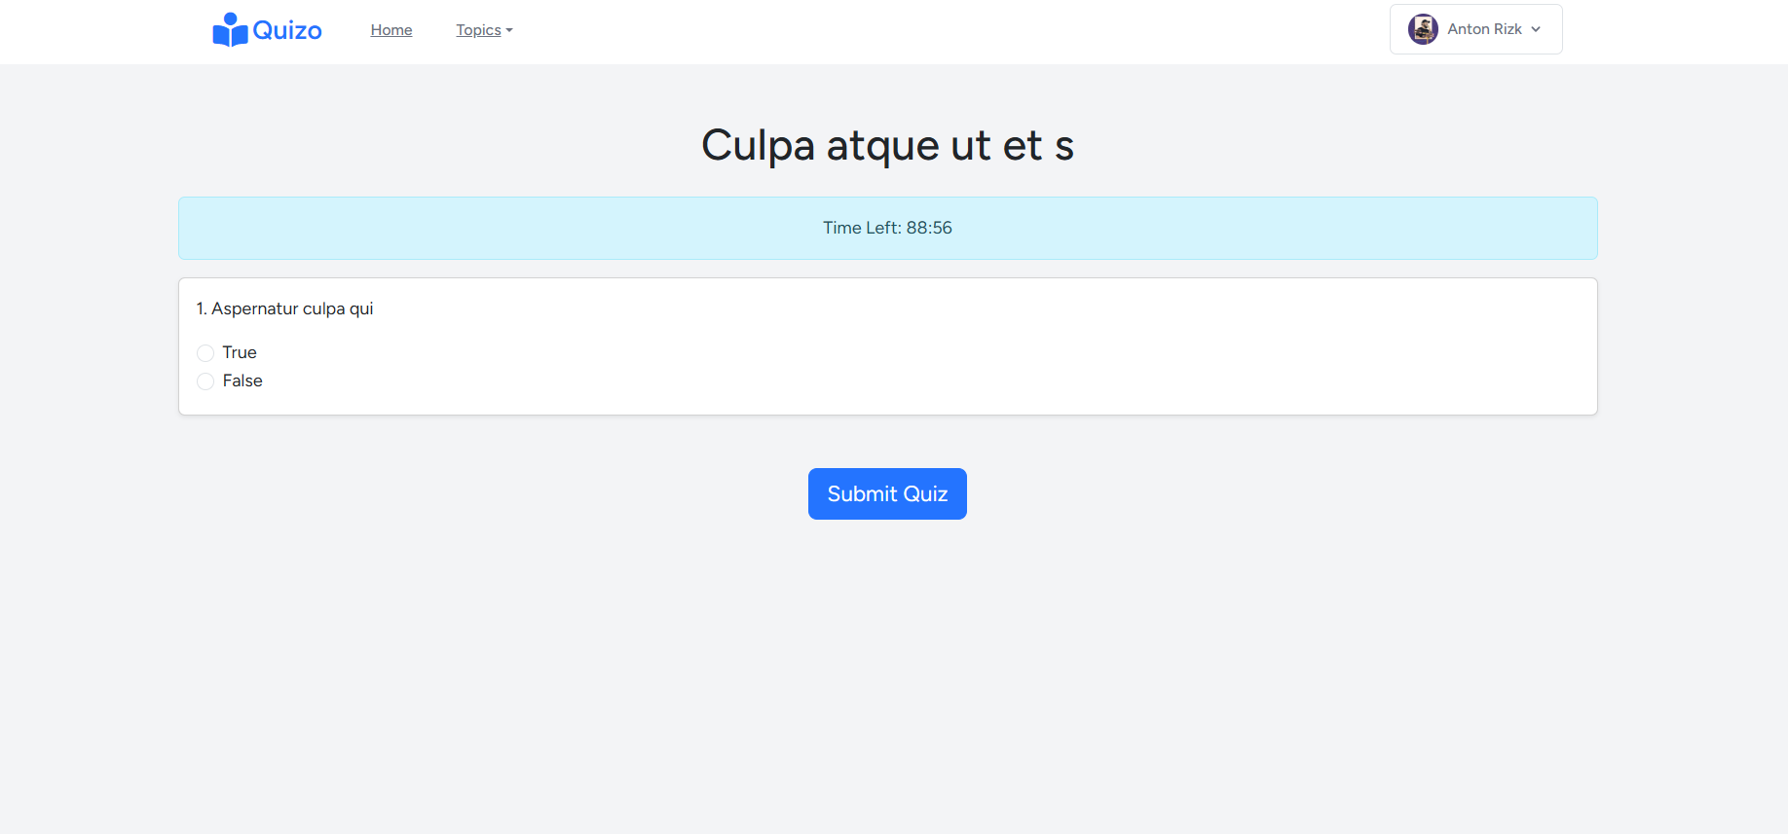
User Dashboard
Quiz taking:
Countdown timer is positioned on top.
Both the questions and their options will appear in a random order to ensure a unique experience for each attempt.
Quiz is automatically submitted when time is out.

Slide 14

Admin Dashboard

Slide 15

Topics Management
Quizzes Management
Users Management

Slide 16

Admin Dashboard
Topics Management
Creating new topics
Editing existing topics
Deleting existing topics

Slide 17
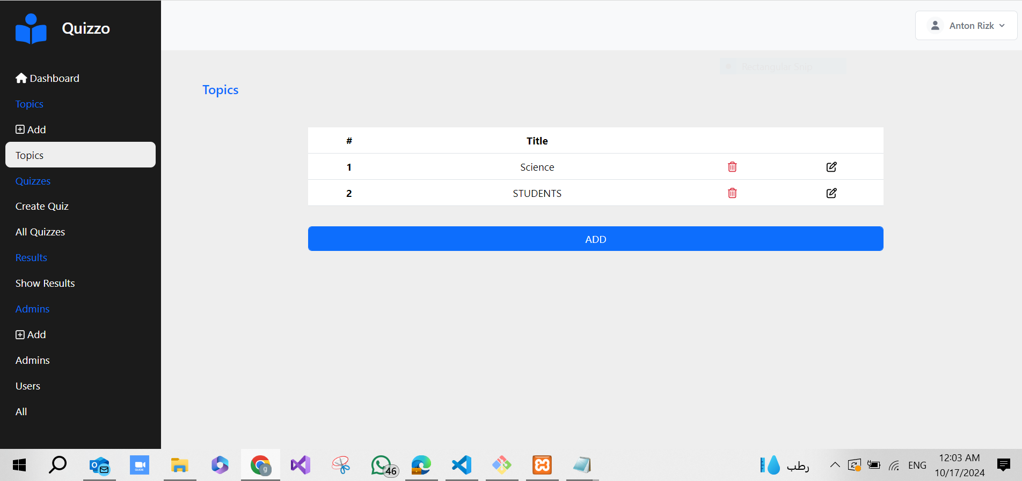
Admin Dashboard
Topics Management

Slide 18
Admin Dashboard
Quizzes Management
Valid for all admins
Creating new quizzes with questions
Uploading images for both quizzes and questions (optional)
Generating reports for performance summaries for each quiz
View quiz takers for each quiz
Valid for the super admin and the quiz creator only
Editing existed quizzes information
Creating new questions for existed quizzes
Editing existed quizzes’ questions
Deleting existed quizzes’ questions
Deleting existed quizzes

Slide 19
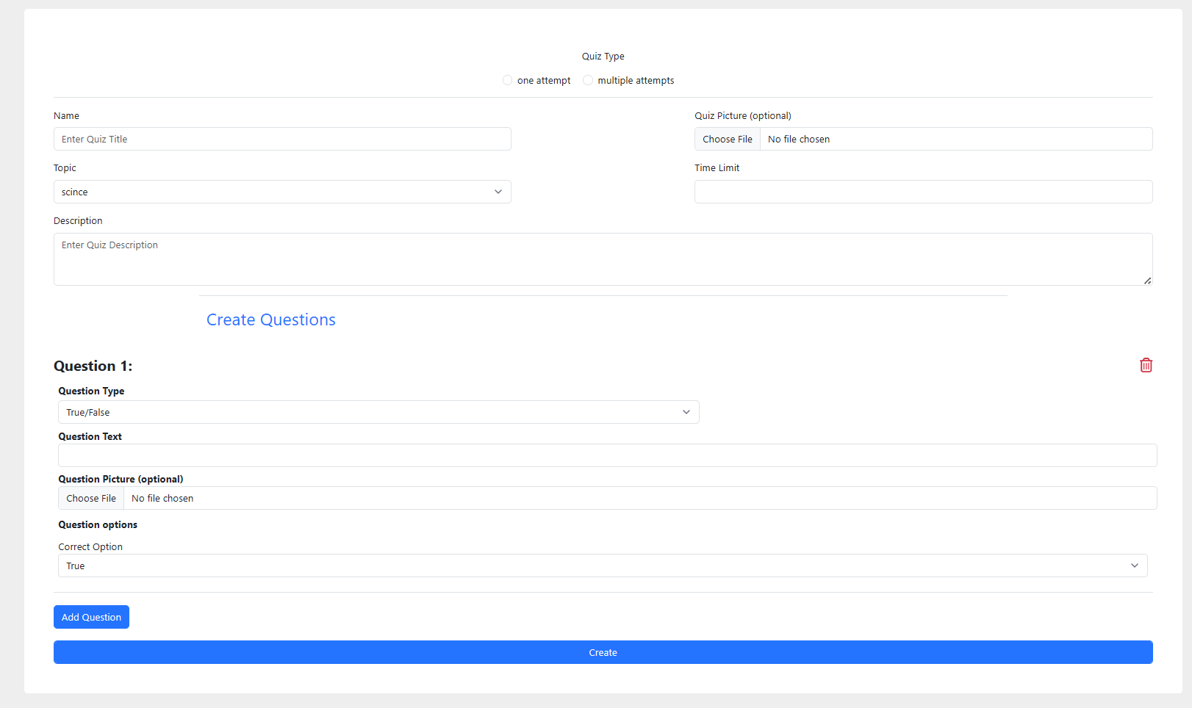
Admin Dashboard
Quizzes Management

Slide 20
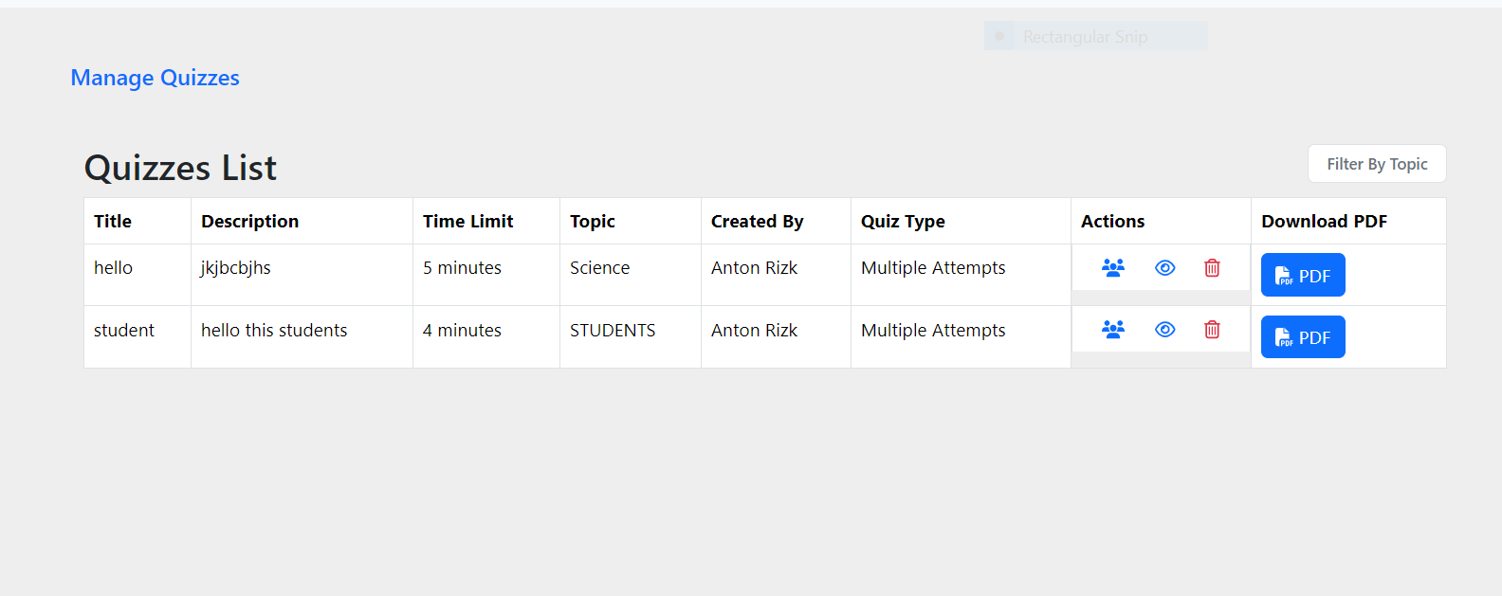
Admin Dashboard
Quizzes Management

Slide 21
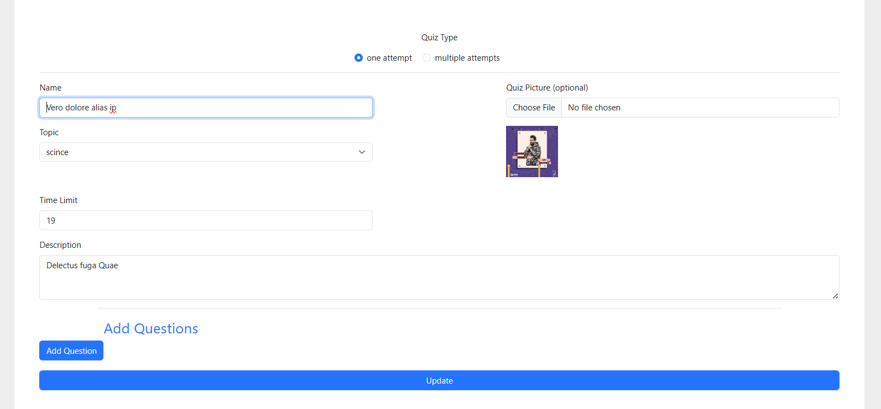
Admin Dashboard
Quizzes Management

Slide 22
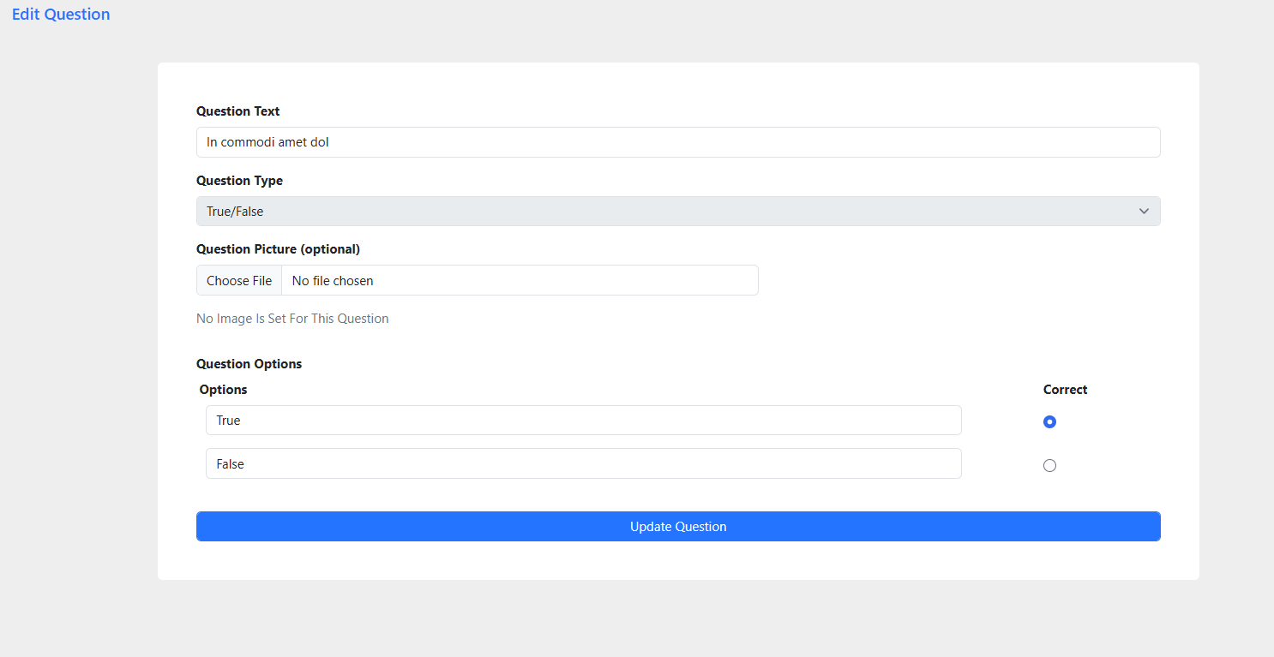
Admin Dashboard
Quizzes Management

Slide 23
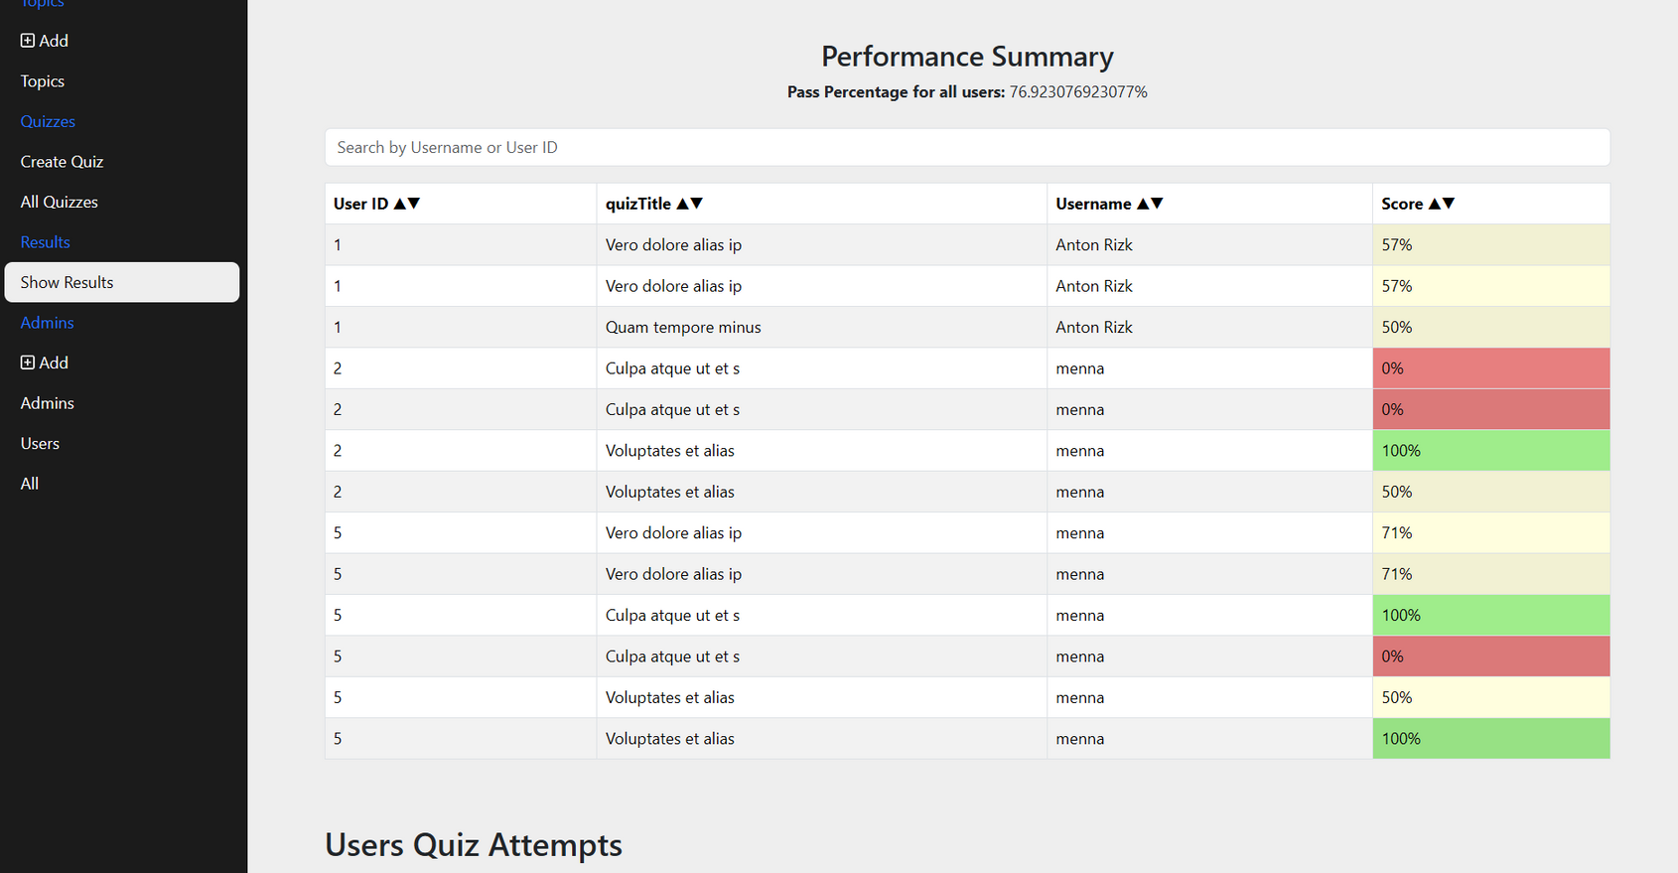
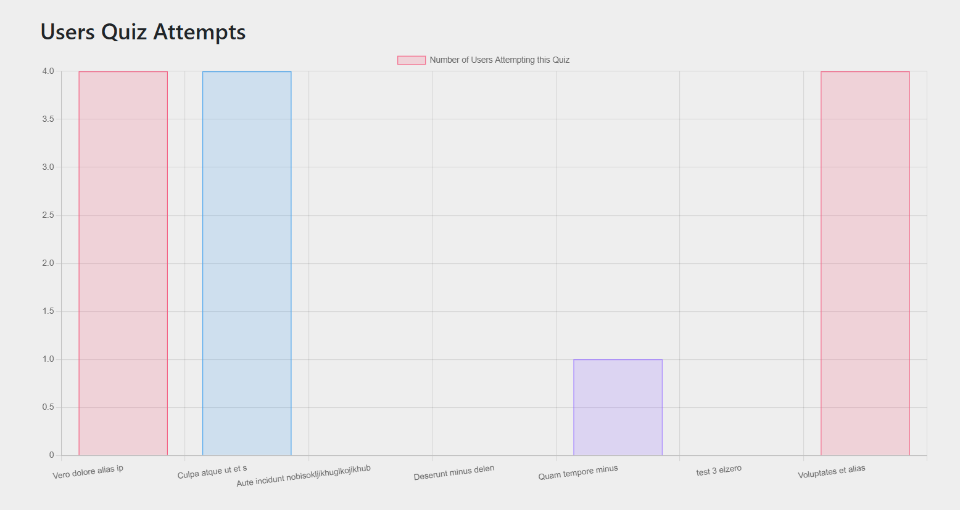
Admin Dashboard
Performance Summary

Slide 24
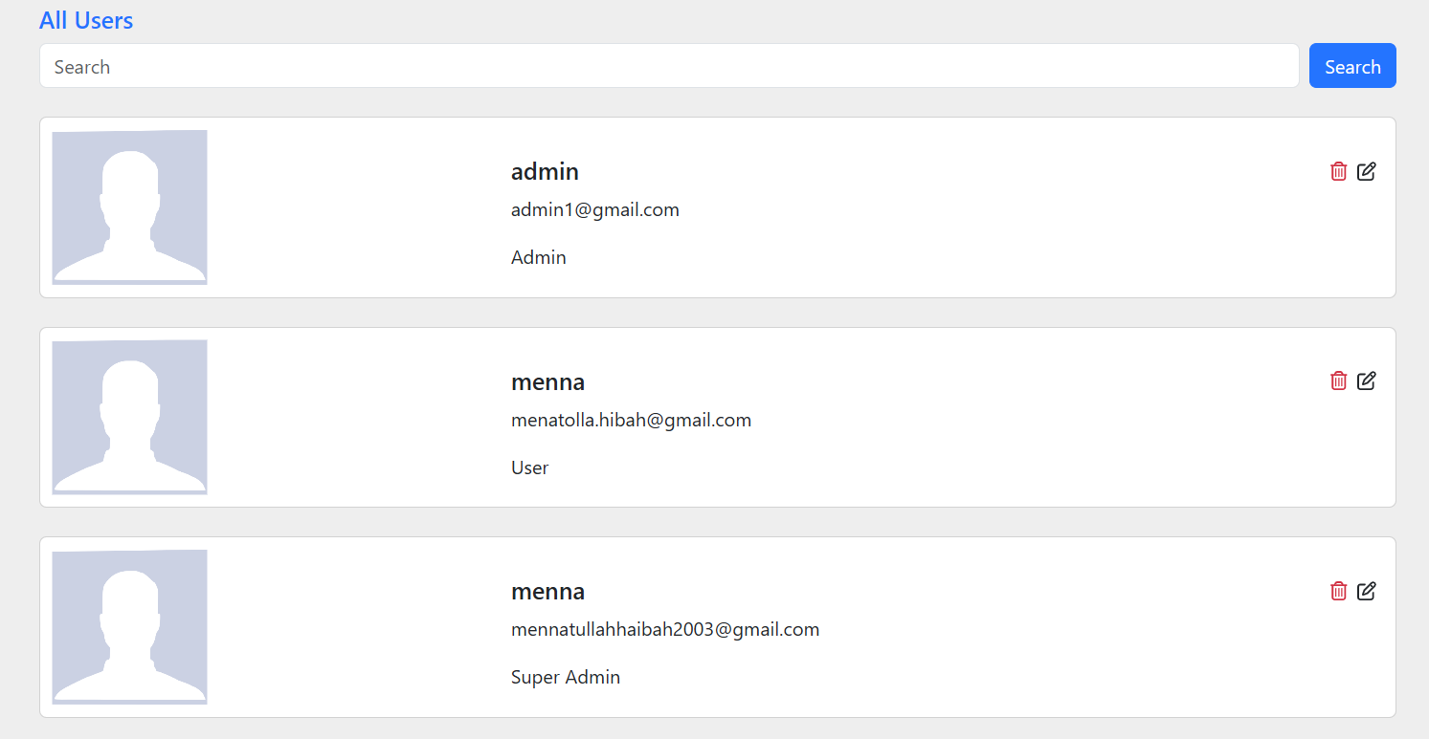
Admin Dashboard
Users Management

Slide 25

Thank You

